Slide 1
Agenda
Introduction
Functionalities of end users(Part01)
Functionalities of end users(Part02)
Functionalities of doctors
Functionalities of technicians

Slide 2

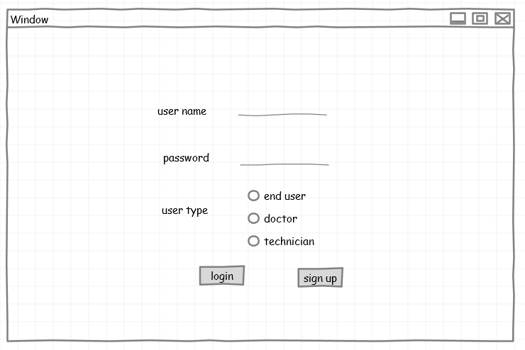
End users

Slide 3
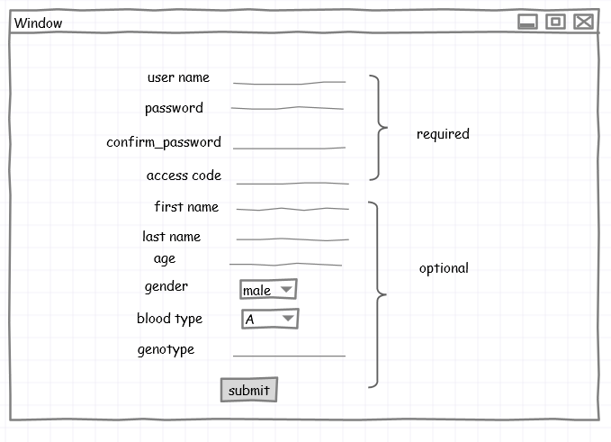
End users

Slide 4
End users

Slide 5
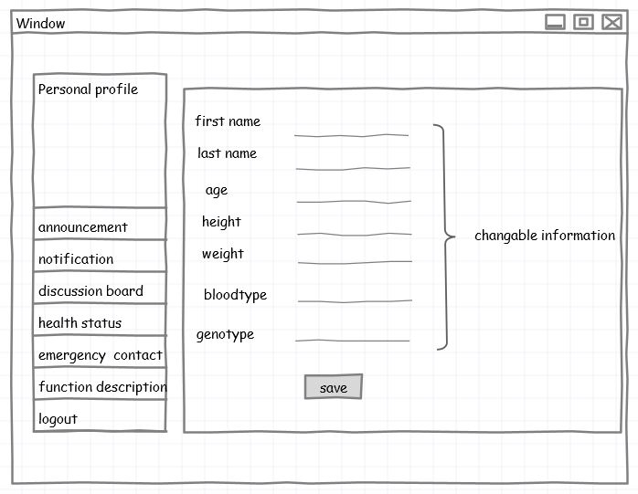
End users

Slide 6
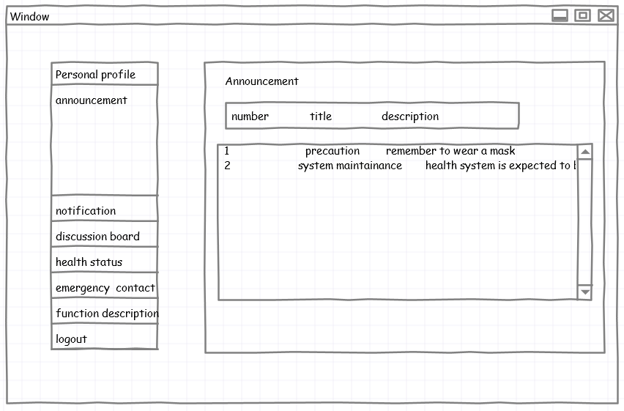
End users

Slide 7
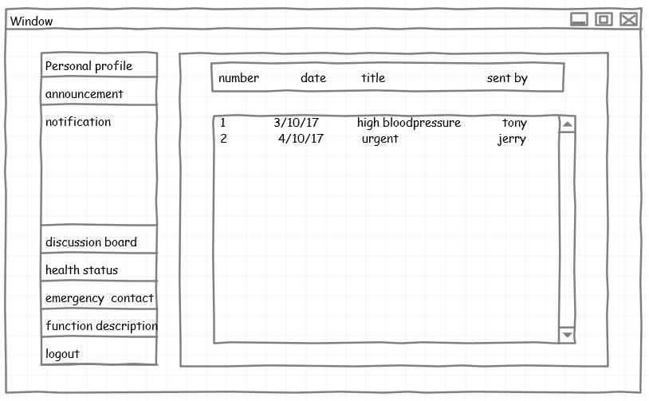
End users

Slide 8
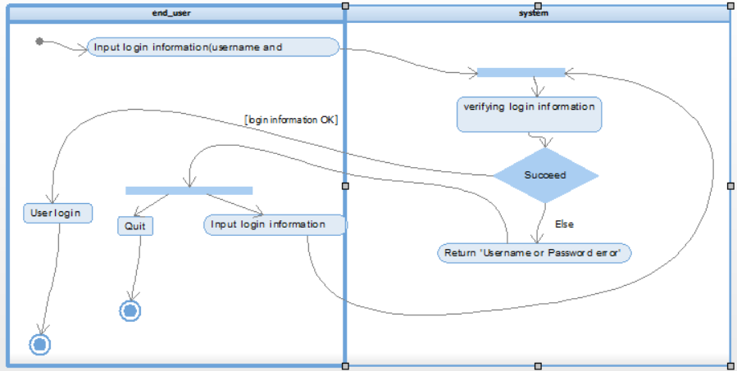
End users
Figure1 Activity diagram for login procedure

Slide 9
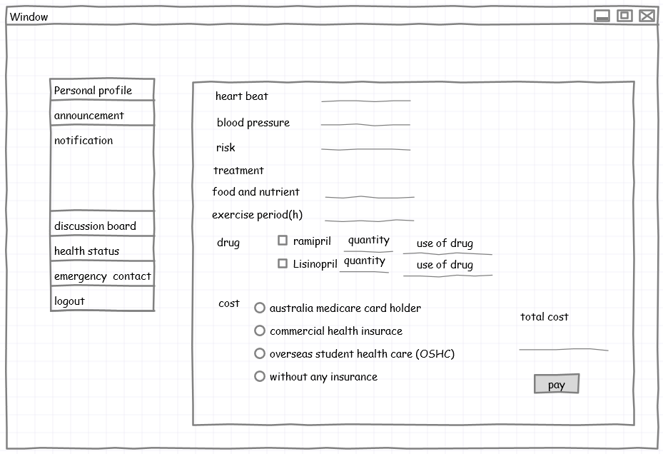
End users

Slide 10
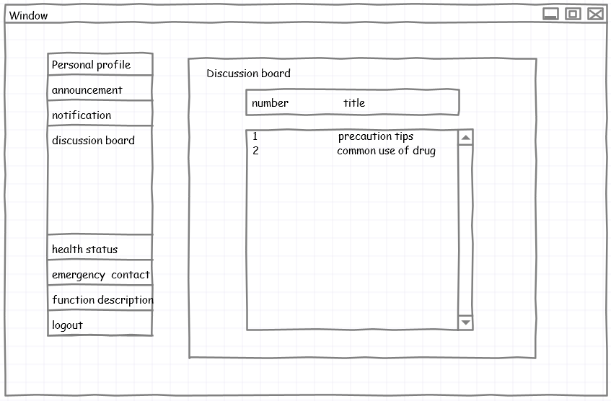
End users

Slide 11
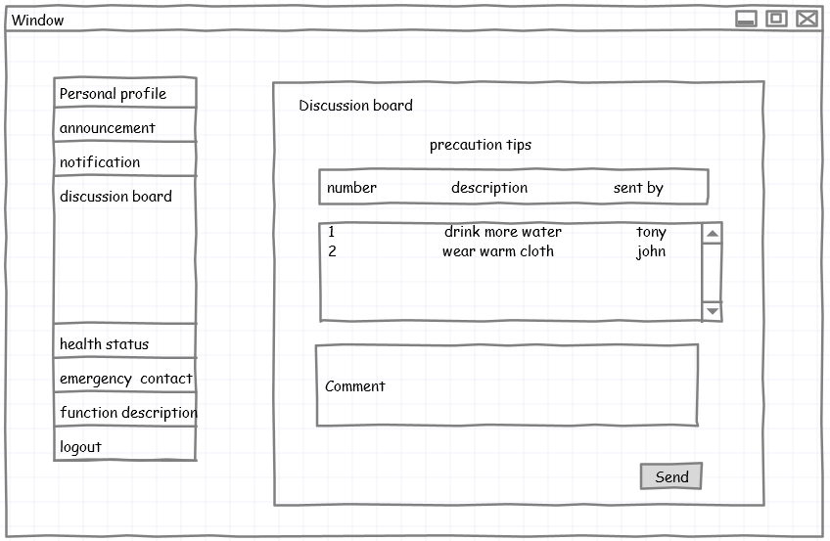
End users

Slide 12
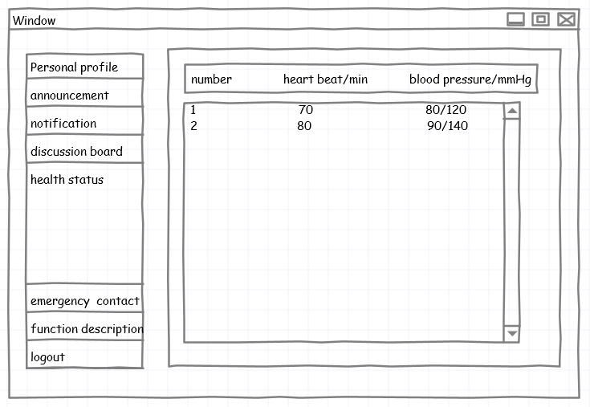
End users

Slide 13
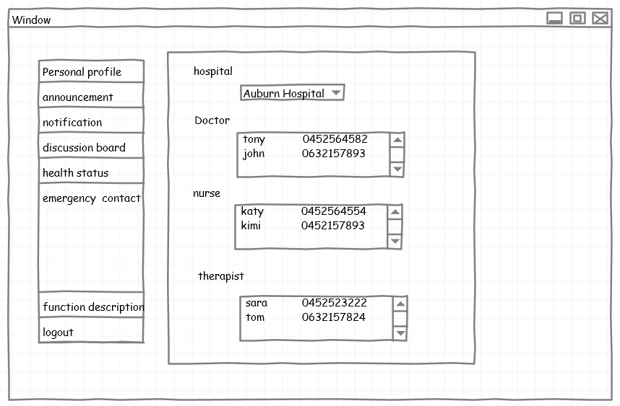
End users

Slide 14
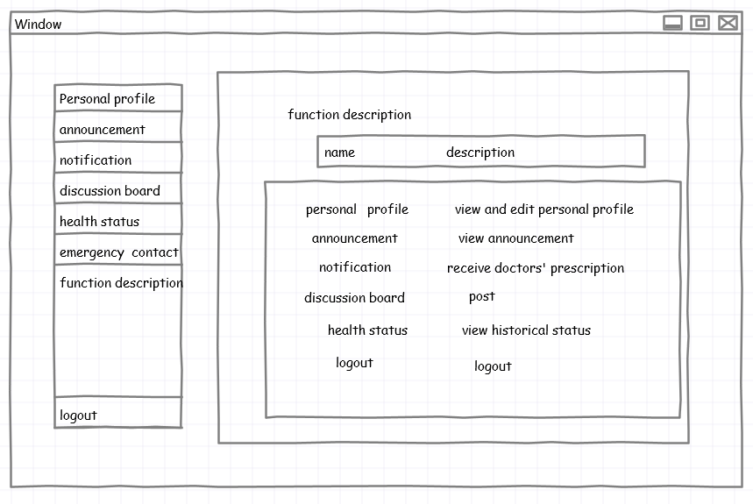
End users

Slide 15
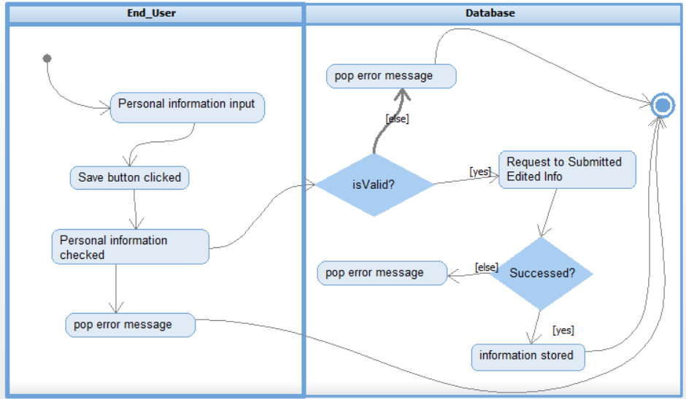
End users
Figure2 Activity diagram for adding personal information procedure

Slide 16

Doctor

Slide 17
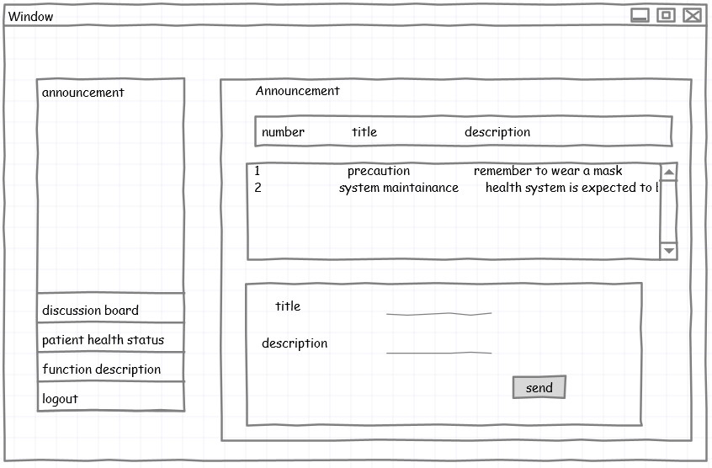
Doctor

Slide 18
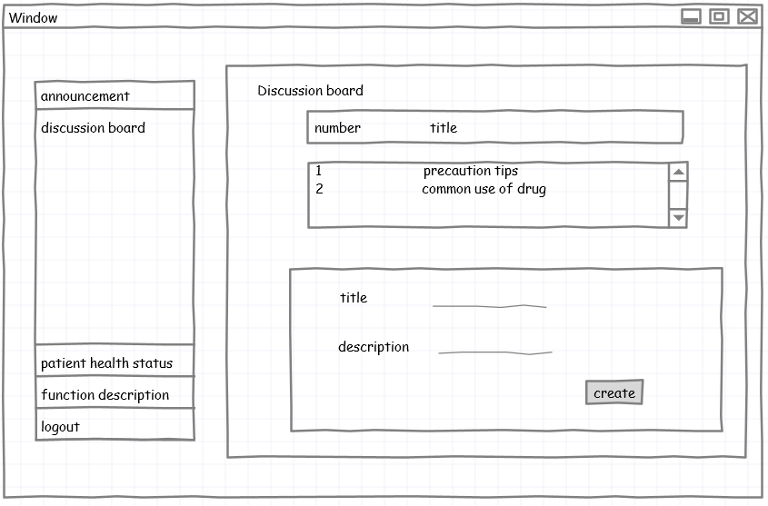
Doctor

Slide 19
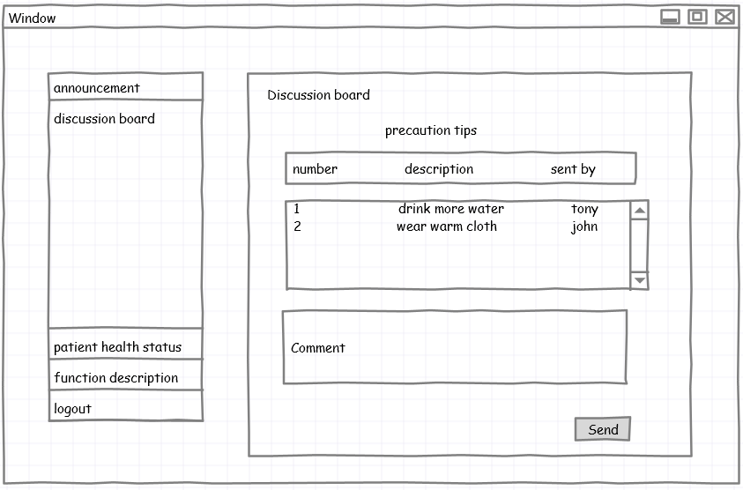
Doctor

Slide 20
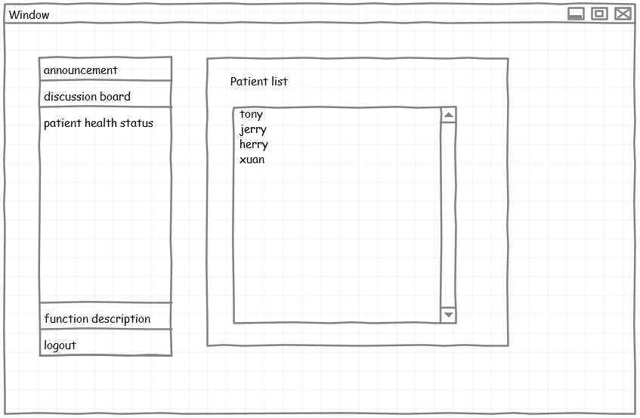
Doctor

Slide 21
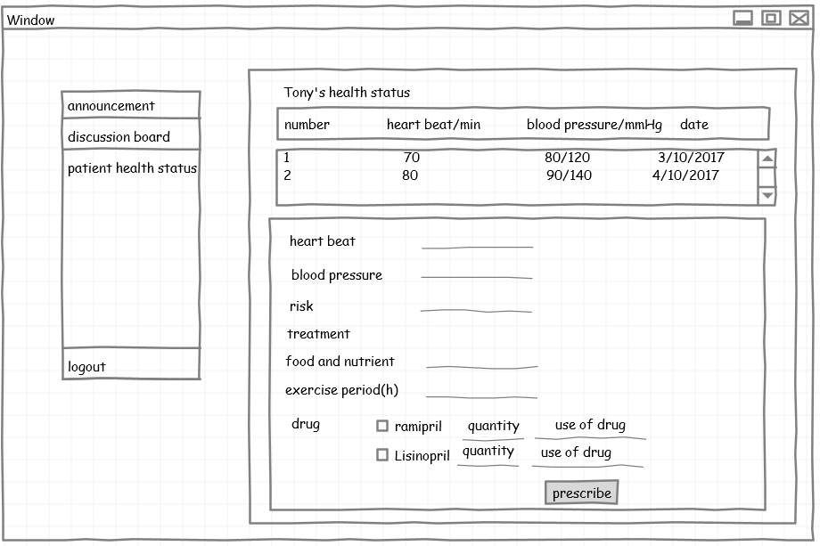
Doctor

Slide 22
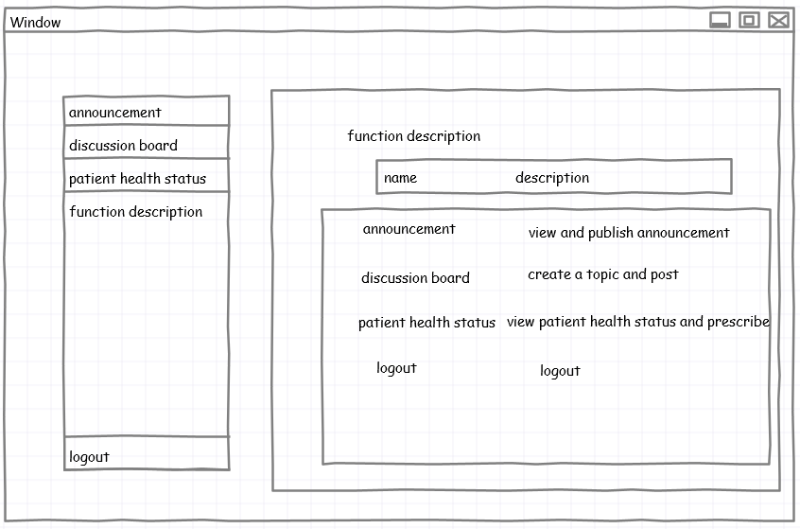
Doctor

Slide 23
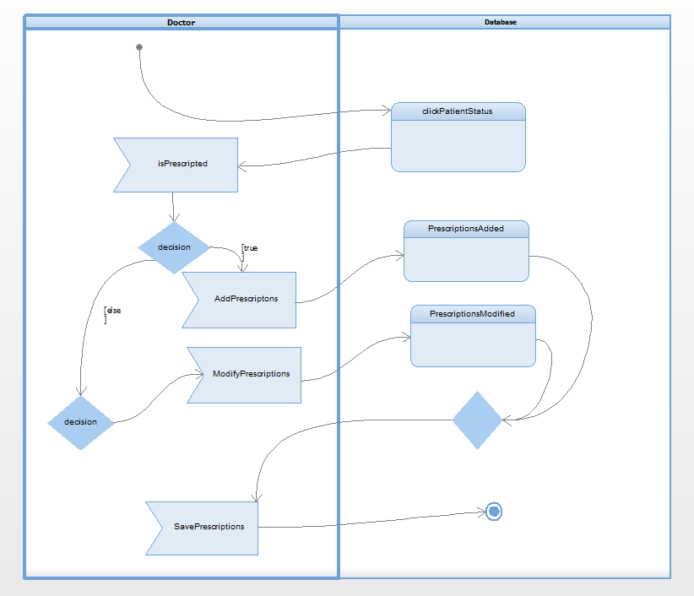
Doctor
Figure3 Activity diagram for making prescription procedure

Slide 24

Technicians

Slide 25
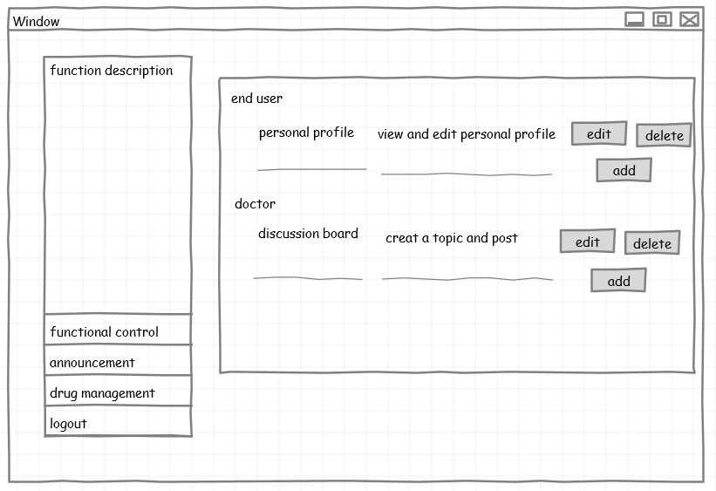
Technicians

Slide 26
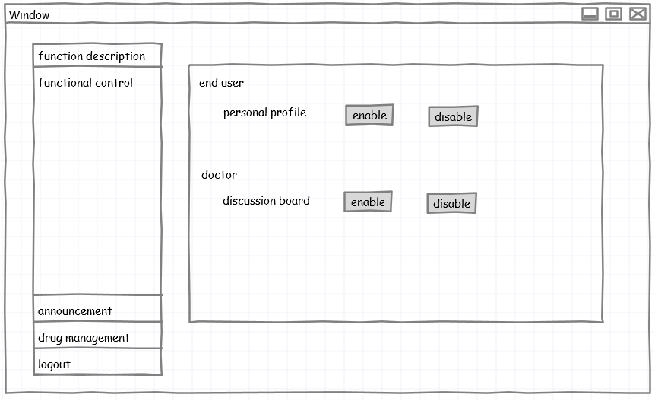
Technicians

Slide 27
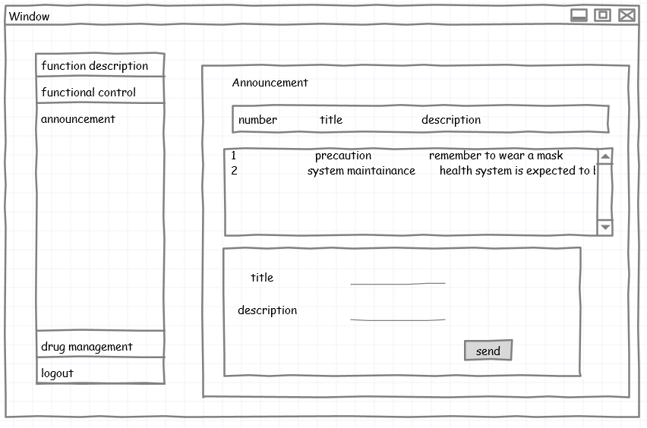
Technicians

Slide 28
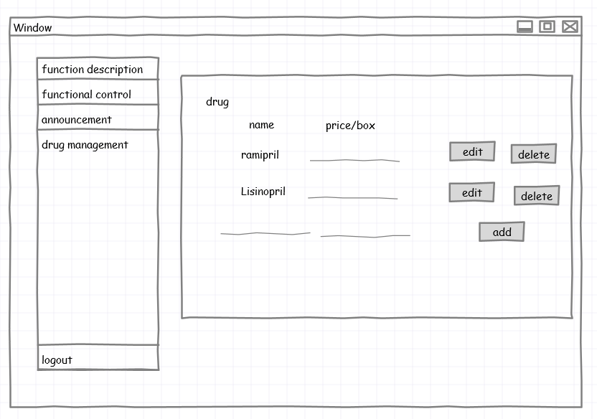
Technicians

Slide 29
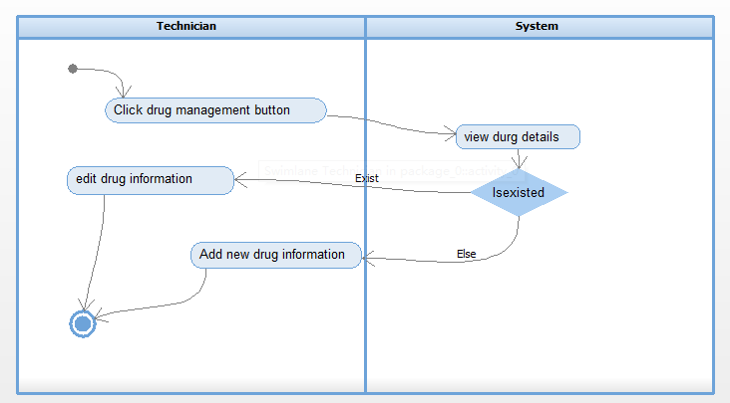
Technicians
Figure4 Activity diagram for drug management procedure

